Slide 1
Covid Effect on Student Academics

Slide 2
MEET THE TEAM
ELLIE MANLEY
MOBOLADE ADETOLA
MO EDITH AKIDELE
Researcher/Analyst
Sector Experience
Economist Background
Researcher/Analyst
Subject Matter Expert(Databases)
Researcher/Analyst
Project Management background
PALPASA SHRESTHA
ROSSANN MOHAMMED
SUSANNA AKINULI
Researcher/Analyst
Research background
Researcher/ Analyst
Subject Matter Expert(Data Analyst)
Researcher/Analyst
Sector Background

Slide 3
TABLE OF CONTENT
INTRODUCTION
ANALYSIS
REFERENCES
An examination of the impact of Covid on education
To understand the impact of Covid 19 on the GSCE performances within London boroughs between the years 2018-19 and 2020 - 2021.
A cataloque of slides highlighting our approach, team roles and other activities supporting our project
Notes:
Breakdown of presentation:

Slide 4
Aim
Scope
We aim to compare GCSE grades in London borough schools before and during the pandemic in order to determine whether online-based learning should be utilized again in schools.
London Borough
2018-19, 2020-21
Gender
Student backgrounds
Means of Analysis
Tools
Pre-analysis was made up of data cleaning efforts and merging of relevant data.
Exploratory analysis to find the mean pass rate and the standard deviation from that value.
Correlation analysis of mean pass rate against student backgrounds.
Pandas
Numpy
Matplotlib
Power BI
G Suite
Overview
Aim
Scope
Means of analysis
Findings
Findings
Initial Descriptive analysis:
Mean strong pass rate among all students: 48.6% pre covid, 56.9% post covid
Mean standard pass rate: 68.44% pre covid, 75.4% post covid
Mean standard pass among boys: 65.2% pre covid, 72.7% post covid
Mean standard pass among girls: 71.6% pre covid, 78.2% post covid
Mean eligibility for fsm: 18.3% pre covid, 23.6% post covid
Notes:
Next page go into detail on analysis

Slide 5
50
40
30
ANALYSIS
20
10
0
Item 1
Item 2
Item 3
Item 4
Item 5

Slide 6
Our Findings(1)
The mean pass rate was significantly higher in the post covid dataset for both the standard and strong pass requirements.
This is potentially due to students being unable to sit in person exams, and therefore being awarded their target grade. This could result in teachers being generous with their estimations, and mitigate some of the individual errors, such as lack of preparation, that occur under exam stress.
Both the girls and boys mean percentage pass rate increased by roughly the same amount. This suggests neither gender was disproportionately affected by Covid 19 learning disruptions. Generally, girls had a higher GCSE Maths and English pass rate than boys.
The mean percentage of students eligible for fsm went up significantly during the pandemic, likely due to the economic hit caused by lockdown, creating more unemployment and less job availability.
Notes:
Mention of fsm needs a different heading to fall under

Slide 7
Our Findings(2)
Standard deviation across all students:
Standard pass was 5.9 Pre covid and 4.8 post covid, suggesting there was less variation in results in 2020, than in the years before covid. This could also be attributed to the difference in exam grading systems, due to the lack of formal exams
Range of post covid GCSE results vs pre covid:
The performance data range was 21% pre covid and 17% post covid, further suggesting less spread in data, post covid GCSE results compared to pre covid.
Power BI approach
The two data sheets that were cleaned and merged using python were exported using:
The exported data sheets were imported in Power BI to create a data model.
A 1:1 relation was created between the two datasets using code_id.
This enables us to analyse the relationships and the two datasets alongside one another.
Notes:
Power bi would fall nicely under visualizations instead
Range necessary? Standard deviation better captures the spread

Slide 8
50
40
30
VISUALISATION
20
10
0
Item 1
Item 2
Item 3
Item 4
Item 5

Slide 9
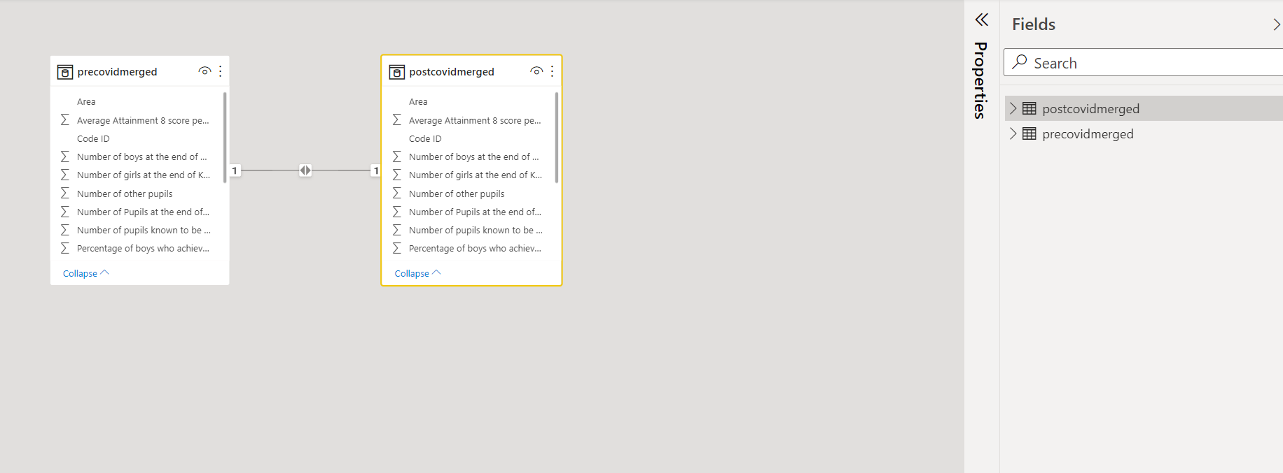
RELATIONSHIP DATA MODEL
A one to one relationship between between the 2 datasets [Pre- Covid & Post Covid data

Slide 10
50
40
30
RESULTS & OBSERVATIONS
20
10
0
Item 1
Item 2
Item 3
Item 4
Item 5
Notes:
Necessary? Same interpretation as findings. Especially when subsequent slides are still visualisations

Slide 11
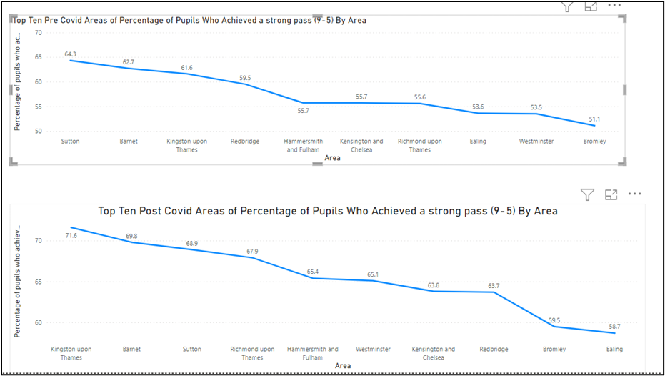
Percentage of students that achieved a strong pass in Top boroughs
The above visualisations show the Top and Bottom Ten graphs of the London boroughs that had the highest percentage of a strong pass (9-5) in Pre-Covid (2018-2019) and Post-Covid (2020-2021). Though, varying from area to area, there was an overall increase in the performance of students between the pre covid and post covid era.

Slide 12
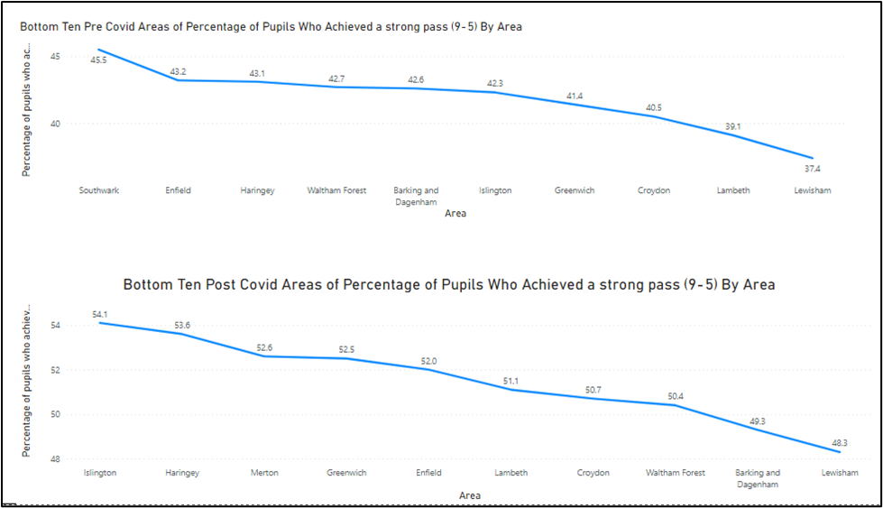
Percentage of students that achieved a strong pass in the bottom boroughs
The bottom ten boroughs also remained the same pre and post covid. Both graphs have similar ranges both coming in at a range of 10% between the minimum and maximum percentage rates of a strong pass. However, in the top mentioned areas, there seems to be a factor that is playing a role in how these schools are in the top ten highest performing London boroughs throughout pre and post covid and why the bottom ten boroughs also remained the same pre and post covid. These top areas are known to be high and working class areas in terms of living standards.

Slide 13
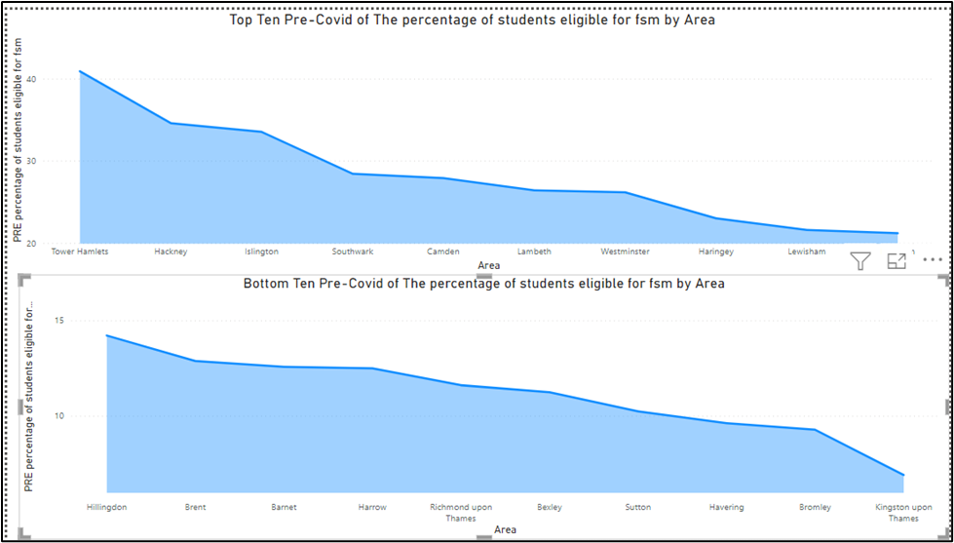
Area vs Free Schools meals eligibility:
The percentage of students for fsm eligibility are shown by filtering out the top ten and bottom ten areas for fsm pre-covid. Here we compare the top 10 top and bottom areas identified above with strong passes with free school meals eligibility. The visualisations below show that the top 10 areas discussed above have low rates of children that were eligible for free school meals compared with the bottom ten with a high rate of children eligible for free school meals. This further speaks to the factor identified above that these are not poor or deprived communities..

Slide 14
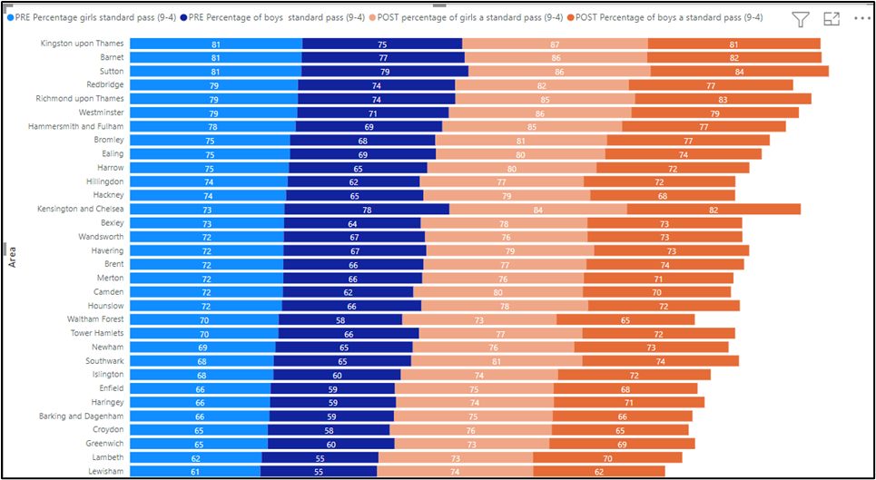
Pre and Post COVID percentage standard pass for girls and boys
In the Post-covid era, this plot shows the performance of students based on genders. The measure of their performance is on a scale of 9-4 and 9-5 out of the 1-9 grading system. This was labelled as a ‘standard pass’ and ‘strong pass’ respectively. Overall, girls performed better than boys in most London boroughs, but the gap was smaller. In Kensington and Chelsea, as seen above also, the boys performed better than the girls for strong pass

Slide 15
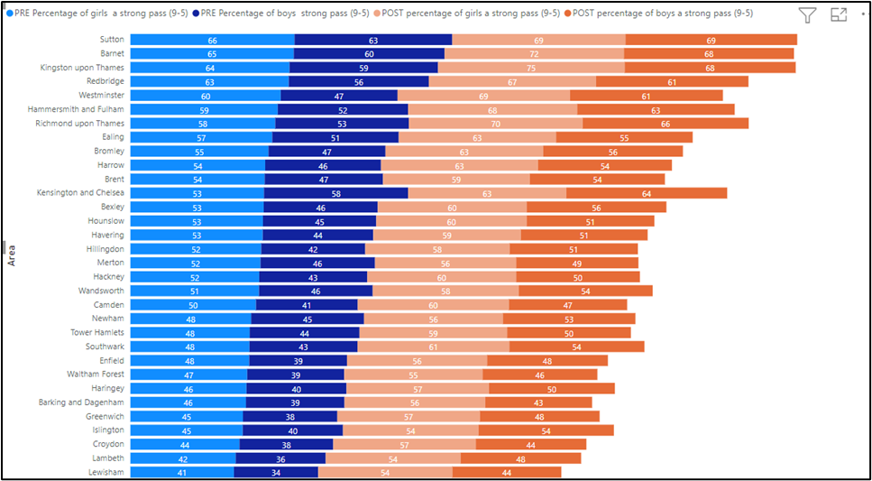
Pre and Post COVID percentage standard pass based on gender and boroughs
In the Post-covid e.ra, this plot shows the performance of students based on genders The measure of their performance is on a scale of 9-4 and 9-5 out of the1-9 grading system. This was labelled as a ‘standard pass’ and ‘strong pass’ respectively. Overall, girls performed better than boys in most London boroughs, but the gap was smaller. In Kensington and Chelsea, as seen above also, the boys performed better than the girls for strong pass.

Slide 16
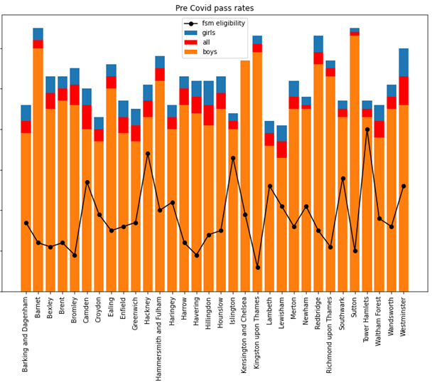
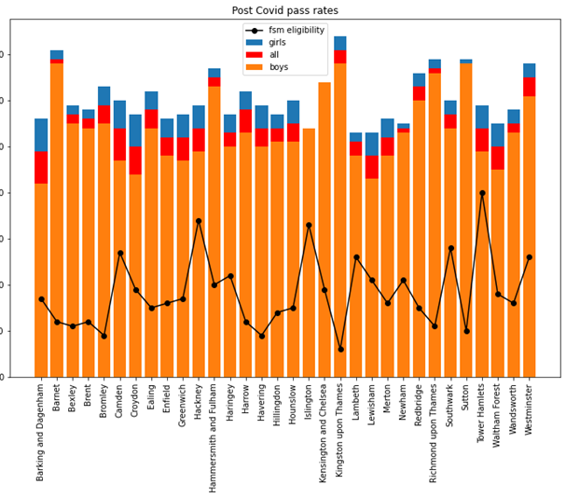
Pre Covid pass rates
The above visualisation is a summary plot, pre and post covid, of the the total number of pupils, boys, and girls results, relative to the eligibility for free school meals within each Borough.

Slide 17
Post Covid pass rates
The above visualisation is a summary plot, pre and post covid, of the the total number of pupils, boys, and girls results, relative to the eligibility for free school meals within each Borough.
Notes:
The above visualisation is a summary plot, pre and post covid, of the the total number of pupils, boys, and girls results, relative to the eligibility for free school meals within each Borough.

Slide 18
LIBRARY & SOURCES
REFERENCES
GCSE Results by Borough - London Datastore
GCSE English and maths results by ethnicity - data.gov.uk
Analysis of results: A levels and GCSEs, summer 2021 - GOV.UK (www.gov.uk)

Slide 19
What was the Original Plan for the Project
INITIAL PLAN
We initially started out looking at online learning and its effect on employability evaluating online learning platforms like Udemy, Coursera, but after a series of of brainstorming sessions we eventually settled for the impact of Covid 19 on education, specifically GCSE performance for Mathematics and English.
GCSE Results by Borough - London Datastore
Notes:
Notes:

Slide 20
Our Project Objectives & Scope
Scope: Project Synopsis
The pandemic brought about a complete dependence on online teaching platforms.
To this end, this project provides the opportunity to evaluate the effects of the pandemic on formal examination processes such as GSCEs, in terms of overall performance and the readiness of schools to transition online.
We also looked at the disproportionate effects it had on financially disadvantaged students, with scarcer access to the internet and technology.
To understand if there were any interruptions to the learning process by evaluating grade performance, with Maths & English as our key focus.
Understanding the difference in performance between the different London Boroughs. [ “The three most expensive boroughs in London” - Westminster, Kensington, Hammersmith & Fulham”) Handson 2021 vs the most deprived areas in London - “Lambeth, Croydon, Islington”. Domman (2019).]
To understand if there is a gender disparity in performance between boys and girls.
Notes:
Notes:

Slide 21
Our Project Aims
After framing our question we set out to achieve these goals:
Collect and merge relevant datasets to extract appropriate information to reach our goals.
To cleanse the data to a high standard to ensure accurate results and observations.
To create useful visualisations to analyse and communicate the data effectively.

Slide 22
Our Approach
The project started off with a series of meetings focused on understanding our data sets and how to ingest and manipulate our data:
To collect and merge relevant datasets to extract appropriate information to reach our goals.
To cleanse the data to a high standard to ensure accurate results and observations.
To create useful visualisations to analyse and communicate the data effectively.

Slide 23
How did we implement and execute?
We adopted a standard data analysis process flow and assigned responsibilities based on an initial Team SWOT Analysis:
Groups: We divided our datasets into two groups (Pre - Covid dataset [2017-18] & Post -Covid[2020 -21]
Group Assignment: Team members were assigned to data sets per interests [ 3 people per dataset]
Responsibility: Each team was to work collaboratively to answer questions on their dataset.
Collaboration/Co-Creators: Both teams merged work under a single notebook and reported on Google Docs to collaborate findings.
Communications/Governance: The team used slack for our weekly huddles, moving in the last week on a daily basis to provide status updates, compare notes and agree next actions.

Slide 24
Name
Roles
SWOT
Rossann Mohammed
Ellie Manley
Susanna Akinuli
Mobolade Adetola
Mo Akidele
Palpasa Shrestha
Subject Matter Expert
Technical Lea/Economist
Researcher/Analyst
Subject Matter Expert
Researcher/Analyst
Researcher/Analyst
Data Analysis
Sector Experience
Sector Experience
Databases
Project Management
Subject Matter Expert
Methodology
Agile: We adopted an agile approach including its basic rituals
Daily Stand-ups via Slack huddles
We adopted Asana as our product backlog tool[Provided the opportunity to track tasks, collectively identify and deal with blockers and general workload]
Twice weekly reviews
Ownership of tasks/activities
TEAM Roles
NAME:
ROLE:
STRENGTH:
Tools
Python Library
Data Source
Numpy
Pandas
Matplotlib
Seaborne
Flask
Slack
Microsoft Office suite
Asana
Power BI
GCSE Results by Borough - London Datastore
GCSE English and maths results by ethnicity - data.gov.uk
Analysis of results: A levels and GCSEs, summer 2021 - GOV.UK (www.gov.uk)
Notes:
Project conclusions

Slide 25
Some Implemation Challenges(1)
We had some major issues with our datasets as well as our API
Issue, risks & Challenges | Mitigation
Data sources did not have API Key | We managed this risk by creating our own API source using the Flask library
Data structure was not designed for the type of analysis we wanted | We managed this issue by using the Python Library - Numpy & Pandas for data cleansing
We had more than one dataset | We managed this issue by merging relevant columns to our data set

Slide 26
Some Implemation Challenges(2)
We had some major issues with our datasets as well as our API
Issue, risks & Challenges | Mitigation
Data sources did not have API Key | API Objective: Initially, our approach with implementing API was to create an API from our GCSE data frame. The API would have been a resource to communicate with the data frame and extract data from the columns. This effort was however held back by a code error.
Issues with API: | Code error which we are still working to resolve. The html produced loads indefinitely.

Slide 27
Analysis Overview
We had some major issues with our datasets as well as our API
Issue, risks & Challenges | Mitigation
Data sources did not have API Key | We managed this risk by creating our own API source using the Flask library
Data structure was not designed for the type of analysis we wanted | We managed this issue by using the Python Library - Numpy & Pandas for data cleansing
We had more than one dataset | We managed this issue by merging relevant columns to our data set

